Slide 1
CONQUEST Quality Standards

Slide 2
CONQUEST quality standards: for the COllaboratioN on QUality improvement initiative for achieving Excellence in STandards of COPD care
Rachel Pullen, Marc Miravitlles, Anita Sharma, Dave Singh, Fernando Martinez, John R Hurst, Luis Alves, Mark Dransfield, Rongchang Chen, Shigeo Muro, Tonya Winders, Christopher Blango, Hana Muellerova, Frank Trudo, Paul Dorinsky, Marianna Alacqua, Tamsin Morris, Victoria Carter, Amy Couper, Rupert Jones, Konstantinos Kostikas, Ruth Murray, David Price
International Journal of Chronic Obstructive Pulmonary Disease 2021:16 2301–2322
CONQUEST is conducted by Optimum Patient Care Global and the Observational and Pragmatic Research Institute and is co-funded by Optimum Patient Care Global and AstraZeneca

Slide 3
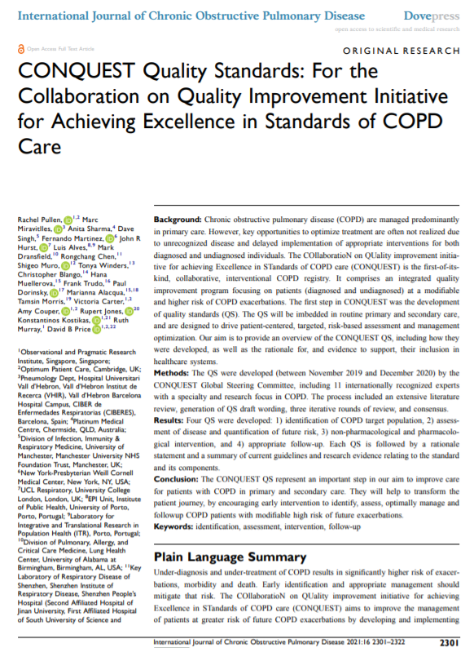
CONQUEST Quality Standards | Background
Globally, the burden of COPD is high and remains a public health priority
It is often underdiagnosed and undertreated in primary care, leading to worsening of disease and increased symptom
CONQUEST is the first-of-its-kind collaborative, interventional, COPD registry with an integrated quality improvement program aiming to improve patient care and outcomes.
Underpinning the CONQUEST programme are
The CONQUEST Quality Standards
These focus on patients (diagnosed and undiagnosed) at a modifiable, but higher risk of COPD exacerbations and adverse cardiac events ("Modifiable high-risk")
Pullen R et al. Int J Chron Obstruct Pulmon Dis 2021:16 2301–2322

Slide 4
The CONQUEST Quality Improvement Programme Underpinned by Quality Standards
The Need for CONQUEST & Programme Background

Slide 5
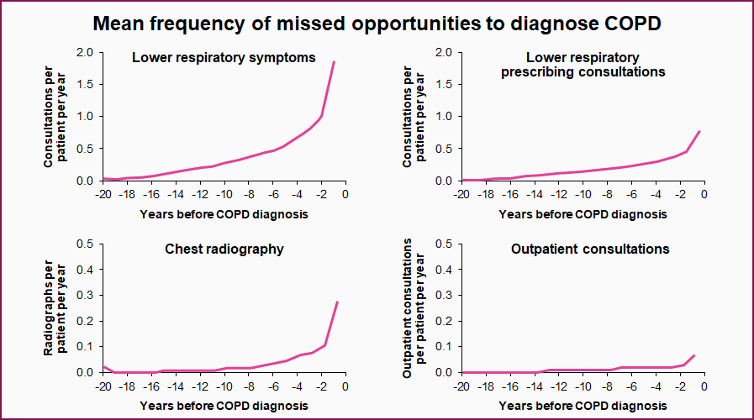
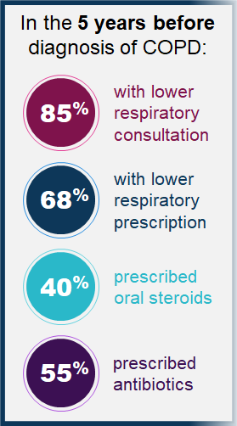
Opportunities To Diagnose COPD Are Often Missed in Primary Care

Slide 6
Future exacerbations¹
Impact of recurrent exacerbations
Lung function²
Cardiovascular events⁵
Recurrent exacerbations
SCS burden ⁴
Quality of Life³
SCS: Systemic Corticosteroid
1. Hurst JR, et al. N Engl J Med 2010; 363 (12): 1128–1138.
2. Kerkhof M, et al. Int J Chron Obstruct Pulmon Dis 2020; 15: 1909-1918
3. Jones PW, et al. Eur Respir J 2014; 44:1156–1165
4. Menzies-Gow et al., Oral Presentation - British Thoracic Society, January 2021
5.Kunisaki KM, et al. Am J Respir Crit Care Med 2018; 198: 51-57
Notes:
History of previous exacerbations is a predictor of future exacerbations
Accelerated lung function decline associated with frequent exacerbations
Increasing systemic corticosteroid burden associated with frequent exacerbations and
steroid-related adverse effects
Negative impact on patient health-related Quality of Life
Increased risk of cardiovascular events, increased morbidity and mortality
Best predictor of future exacerbations:
Hurst, J. R.; Vestbo, J.; Anzueto, A.; Locantore, N.; Müllerova, H.; Tal-Singer, R.; Miller, B.; Lomas, D. A.; Agusti, A.; Macnee, W.; Calverley, P.; Rennard, S.; Wouters, E. F. M.; Wedzicha, J. A.; Evaluation of COPD Longitudinally to Identify Predictive Surrogate Endpoints (ECLIPSE) Investigators. Susceptibility to Exacerbation in Chronic Obstructive Pulmonary Disease. N. Engl. J. Med. 2010, 363 (12), 1128–1138. https://doi.org/10.1056/NEJMoa0909883.

Slide 7
Evidence for Under and Over-treatment of COPD patients based on UK data
Halpin DG, Price D et al. E Clinical Med 2019; 14:32-41
Appropriateness of therapy in COPD patients on maintenance therapy with ≥ 2 exacerbations and mMRC <2 in 2014*
Appropriateness of therapy in COPD patients on maintenance therapy with ≥ 2 exacerbations and mMRC ≥2 in 2014*
(N=93)
(N=893)
(N=520)
(N=96)
(N=1,040)
(N=640)
Under treatment observed in all COPD patient groups, irrespective of blood eosinophil count and symptom burden
*according to the GOLD 2019 report, based on dyspnea, exacerbation frequency and blood eosinophil counts (‘eos’) at Index Date.
Notes:
Over- & under-treatment defined as per Supplemental Table S1 & Supplemental Table S2 https://www.ncbi.nlm.nih.gov/pmc/articles/PMC6833455/bin/mmc1.docx
https://doi.org/10.1016/j.eclinm.2019.07.003

Slide 8
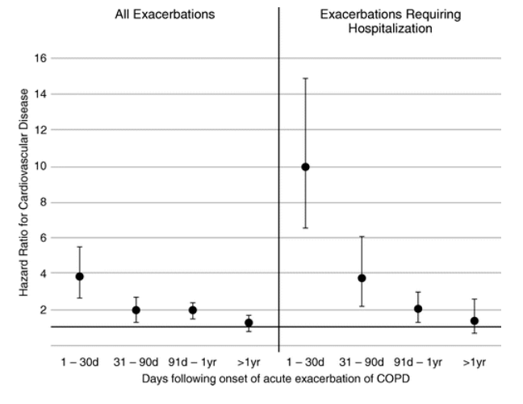
COPD Exacerbations linked to increased Cardiovascular Event Risk
Post-hoc analysis from SUMMIT trial
COPD patients with CVD or risk factors for CVD + ≥1 exacerbation
~4x
overall in subsequent CVD events vs pre-exacerbation period
HR 9.9
(95% CI 6.6 - 14.9)
HR 3.8
(95% CI 2.7 - 5.5)
Relationship present regardless of cardiac history at outset
Kunisaki KM, et al Am J Respir Crit Care Med 2018;198:51–57; CI: Confidence Interval; CVD: cardiovascular disease ; HR: Hazard Ratio ; SUMMIT: Study to Understand Mortality and Morbidity in COPD
Notes:
Hazard Ratio 3.8 (95% CI 2.7-5.5)
Kunisaki: CVD events were a composite outcome of cardiovascular death, myocardial infarction, stroke, unstable angina, and transient ischemic attack. All CVD events were adjudicated.
Kunisaki, K. M.; Dransfield, M. T.; Anderson, J. A.; Brook, R. D.; Calverley, P. M. A.; Celli, B. R.; Crim, C.; Hartley, B. F.; Martinez, F. J.; Newby, D. E.; Pragman, A. A.; Vestbo, J.; Yates, J. C.; Niewoehner, D. E.; SUMMIT Investigators. Exacerbations of Chronic Obstructive Pulmonary Disease and Cardiac Events. A Post Hoc Cohort Analysis from the SUMMIT Randomized Clinical Trial. Am. J. Respir. Crit. Care Med. 2018, 198 (1), 51–57. https://doi.org/10.1164/rccm.201711-2239OC.

Slide 9
The Need For Improved Quality of Care – Goals for COPD Management in the USA & UK
USA COPD National Action Plan
UK Department of Health
Raising public awareness of COPD
Educate key stakeholders in diagnosis, prevention
& treatment
Encourage data sharing
& dissemination
Pullen R et al. Int J Chron Obstruct Pulmon Dis 2021:16 2301–2322

Slide 10
Driving patient-centred, targeted, and risk-based assessment to empower patients and physicians to improve COPD care for both diagnosed and undiagnosed modifiable high-risk patients
CONQUEST: Programme Vision
Closing gaps in current COPD care provision
Embedding CONQUEST Quality Standards in routine primary care
Integrating information from patients
Presenting this information to clinicians
Pullen R et al. Int J Chron Obstruct Pulmon Dis 2021:16 2301–2322
Notes:
(*) For more information on the PREVAIL cluster randomised trials, please refer to the PREVAIL press release: https://opri.sg/latest-news/evaluating-the-impact-of-targeted-risk-based-management-in-patients-with-modifiable-high-risk-copd/

Slide 11
The CONQUEST Quality Improvement Programme Underpinned by Quality Standards
The Development of the CONQUEST Quality Standards

Slide 12
Principles Considered in Development of Evidence-Based Quality Standards (QS) for CONQUEST
Making the QS practical & easy to use for all stakeholders (e.g., clinicians, policy makers, advocacy groups)
Ensuring the QS are feasible to implement in routine clinical practice
Future-proofing the QS by advocating general principles rather than a stringent and didactic approach
Ensuring QS adherence and impact on disease outcomes can be compared across healthcare systems
Accounting for intercountry differences in COPD burden (morbidity, mortality, socioeconomic)
“These Quality Standards are core research and evidence-based statements that underpin the CONQUEST initiative and are intended to cover care for a targeted COPD population, a large proportion of whom may be positively impacted by quality COPD care.”
Pullen R et al. Int J Chron Obstruct Pulmon Dis 2021:16 2301–2322

Slide 13
CONQUEST Target Populations : Modifiable High-risk (MHR) Patients
Modifiable High-Risk
Aged ≥40 with COPD (or potential COPD) with ≥2 moderate, or ≥1 severe exacerbations in last 12 months
AND whose medical record data indicates clearly that there is scope for management optimisation
Undiagnosed patients with potential MHR COPD
Diagnosed MHR
COPD patients

Slide 14
Overview of CONQUEST Quality Standards, Specific to Patients with Modifiable High-risk COPD
1. Identification of target population
Identify individuals ≥40 years of age (with or without a COPD diagnosis) with a history of smoking or relevant environmental exposure, at increased risk of exacerbations, morbidity, and mortality and with scope for COPD management optimization.
And, within this population, to identify those with greater cardiovascular risk.
2. Assessment of disease & quantification of future risk
Perform thorough phenotyping, assessment of underlying biological traits and risk prediction of all patients identified within the target population.
Quality Standard 1
Quality Standard 2
CONQUEST
Quality Standards
CONQUEST Quality Standards
Quality Standard 4
Quality Standard 3
4. Follow up
Ensure regular follow up to address pharmacological and non-pharmacological interventions, symptoms review & risk prevention and lifestyle risk factors
3. Non-pharmacological and pharmacological Intervention
Target therapeutic interventions according to individual risk assessment and biological traits
Pullen R et al. Int J Chron Obstruct Pulmon Dis 2021:16 2301–2322

Slide 15
The Four Quality Standards
Detailed Description of Each CONQUEST Quality Standard

Slide 16
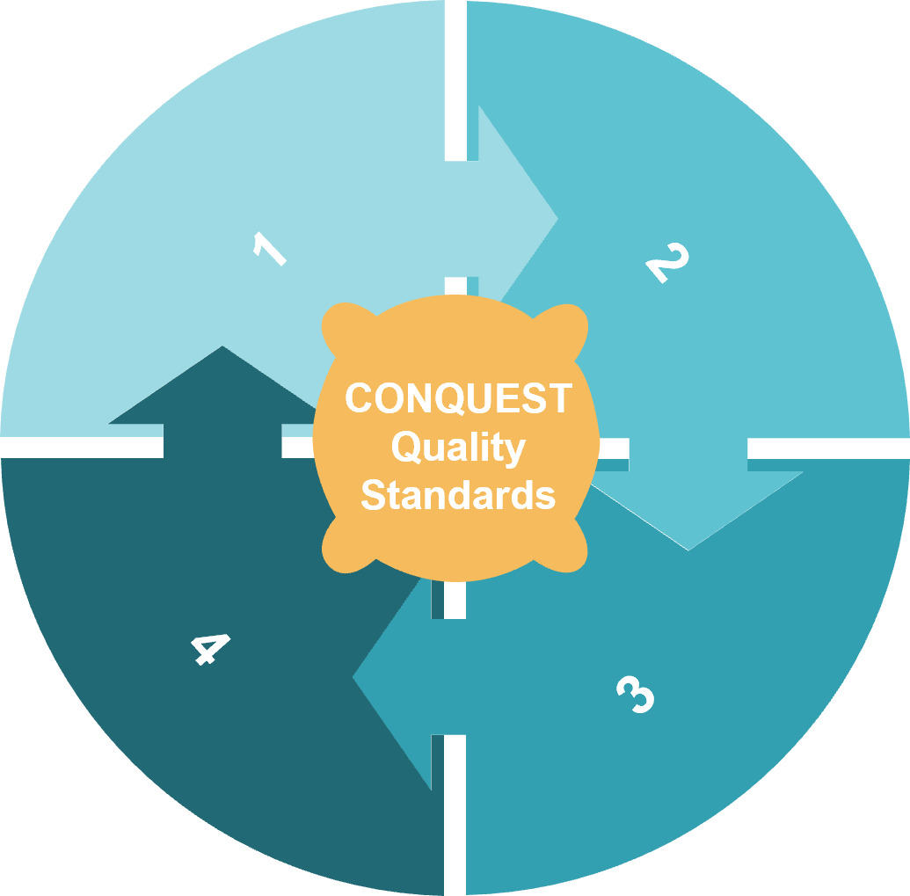
Quality Standard #1: Identifying The Target Population
Patients
≥40 years old
With or without a COPD diagnosis
History of smoking/relevant environmental exposure
Increased risk of exacerbations, morbidity, and mortality
Scope for COPD management optimization (i.e., modifiable high-risk disease)
Identify those with
greater cardiovascular risk within this population
Rationale
Goals of optimized management
Early intervention would slow the speed of disease progression
Patients at risk of exacerbations require more intense focus on identification, assessment, and treatment optimization
Reduce exacerbation rate
Reduce/attenuate lung function decline
Improve patient health-related quality of life
Decrease cardiovascular risk associated with exacerbations
Pullen R et al. Int J Chron Obstruct Pulmon Dis 2021:16 2301–2322
Notes:
Target population

Slide 17
Quality Standard #2: Assessing Disease and Quantifying Future Risk
Phenotype patients
Assess underlying biological traits
Predict individual risk
Disease assessment
Risk assessment
͏Symptomatic assessment via the COPD Assessment Test (CAT) and MRC dyspnea scale
͏Post-bronchodilator spirometry to confirm diagnosis and track lung function
Measuring blood eosinophil counts to guide therapy
͏Imaging to evaluate disease, consider other respiratory pathologies, and potentially phenotype patients
Identifying comorbidities
͏Body Mass Index (BMI) evaluation to aid in prediction of exacerbation risk, mortality, and comorbidities
͏Cardiovascular (CV) risk evaluation
Evaluation with validated multicomponent risk assessment indices
Evaluation of cigarette smoke exposure and physical activity levels
Pullen R et al. Int J Chron Obstruct Pulmon Dis 2021:16 2301–2322
Notes:
Add icons

Slide 18
Quality Standard #3: Non-pharmacological and Pharmacological Intervention
Individual risk assessment
Accounting for biological traits
Targeted therapeutic intervention
Non-pharmacological interventions | Pharmacological interventions
Smoking cessation interventions as appropriate | Dual bronchodilators if symptomatic on LABD monotherapy
Pulmonary rehabilitation referrals, where indicated | Triple therapy when appropriate
Long-term oxygen therapy, where indicated | Adequate and prompt therapy for cardiac risk factors & disease
Pneumococcal & annual influenza vaccination to all with COPD | Regularly assess inhaler choice and technique
Enhancing patient motivation and engagement with patient reported outcome information & shared decision-making | Short courses of oral steroids and/or antibiotics during exacerbations
Abbreviations: LABD = long-acting bronchodilators
Pullen R et al. Int J Chron Obstruct Pulmon Dis 2021:16 2301–2322

Slide 19
Quality Standard #4: Appropriate Follow Up
Initial visit
Follow-up
Follow-up
Follow-up
Timely clinical review for ongoing symptom evaluation,
risk prediction, and lifestyle risk factor assessment
What should occur during follow-up visits?
Medication, inhaler device & symptom review
Inhaler technique assessment
Smoking cessation advice/intervention
BMI calculation and nutritional advice; specifically, a referral for dietetic advice for patients with low/high BMI
Pulmonary rehabilitation referral for suitable patients
Vaccination in accordance with local policy
Improving patient motivation and engagement with their treatment plan
Goals of follow-up:
long-term strategies to encompass the pharmacological, clinical & non-pharmacological aspects of COPD management
Pullen R et al. Int J Chron Obstruct Pulmon Dis 2021:16 2301–2322

Slide 20
Conclusions
Takeaway Messages from the Quality Standard Manuscript & Next Steps for the CONQUEST Programme

Slide 21
Quality Standards Manuscript | Conclusions
The CONQUEST Quality Standards are the first step in transforming the patient pathway to improve the care of COPD patients in primary and secondary care internationally
These Quality Standards will be a useful tool in identifying high-risk patients with modifiable disease, optimizing their management, and ensuring appropriate follow up to reduce symptoms, exacerbations, comorbidity and mortality
Moving forward, CONQUEST will advocate for appropriate and early interventions to slow disease progression and optimize patient outcomes; it will also utilize shared decision-making to lock in behavioural change and generate transformational evidence to measure treatment success in the real world
Pullen R et al. Int J Chron Obstruct Pulmon Dis 2021:16 2301–2322

Slide 22
Next Steps for the CONQUEST QI Programme
Translation of the Quality Standards into Quality Improvement Programme operational protocols
These protocols will describe the core components of the programme required to implement CONQUEST in a healthcare system or a practice
Select regions of the UK & USA have been identified as initial targets for the CONQUEST intervention
An Opportunity Analysis will be conducted in both countries using retrospective analysis of EMR data to compare the Quality Standards with current practice – highlighting opportunities for management optimisation
The impact of CONQUEST on COPD outcomes will be evaluated by a cluster randomized trial (PREVAIL) in each country
Pullen R et al. Int J Chron Obstruct Pulmon Dis 2021:16 2301–2322
Notes:
To be recreated by AC

Slide 23
For More Information on the CONQUEST Quality Standards
View the full article here: https://www.dovepress.com/article/download/67814

